Slide 1
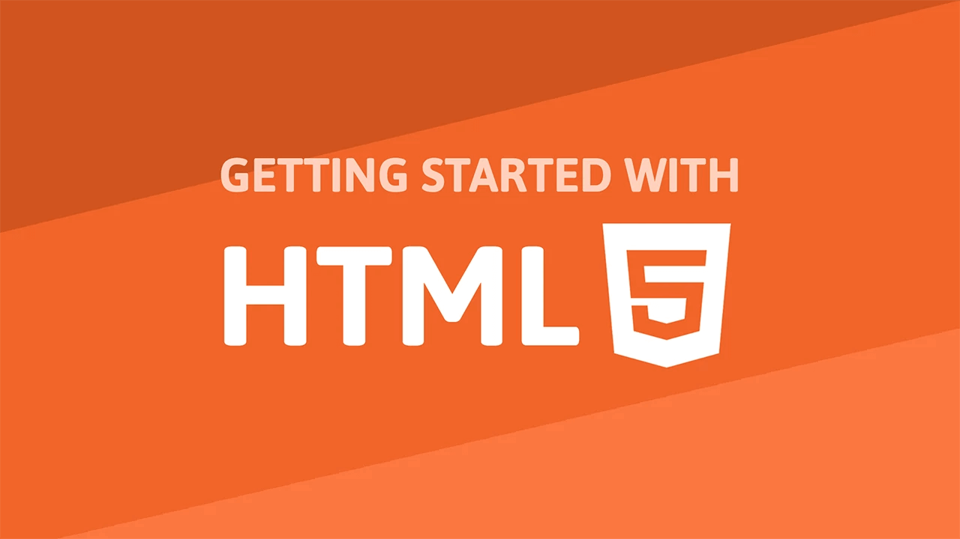

Slide 2
Overview
HTML stands for Hypertext Markup Language
HTML is not a programming language, It is a markup language that defines the structure of your content
Every Website is made of HTML
UI Developer combines the art of design with the art of programming.
Responsible for translation of the UI/UX design wireframes to actual code.

Slide 3
Structure of an HTML
An HTML document has two main parts:
The HEAD element is a container for metadata (data about data).
2. The BODY of an HTML document is where all the information you wish to view must appear.

Slide 4
Elements, Tags & Attributes
HTML Elements:
The element consists of both the opening and closing tags.
It normally consists of some structure that’s used to define the respective tags.
HTML Tag:
Tags are used to define the beginning and end of an HTML element.
They consist of an opening bracket ( < ), followed by the name of the element and then a closing bracket ( > ).

Slide 5
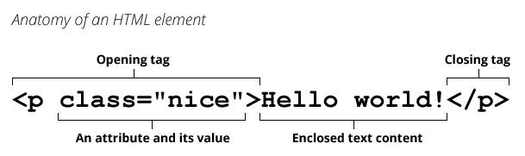
Elements, Tags & Attributes
HTML Attributes:
HTML Attributes are used to define a property for one or more HTML elements. They are found within the element’s opening tag.

Slide 6
Heading & Paragraph Tag
Headings:
Heading elements allow you to specify that certain parts of your content are headings or subheadings.
Paragraphs:
Paragraph elements are for containing paragraphs of text.

Slide 7
Div and Span Tag
Div Tag:
The <div> tag defines a division or a section in an HTML document.
The <div> element is often used as a container for other HTML elements
It is a block level element
Span Tag:
The HTML <span> tag is used for grouping and applying styles to inline elements.

Slide 8
Links, Nested and Comment
Links:
Links allow users to click their way from page to page.
Nesting Elements:
You can put elements inside other elements too — this is called nesting.
Comments:
Comment tags are used to insert comments in the HTML source code

Slide 9
Forms and Button
HTML Forms:
HTML Forms are one of the main points of interaction between a user and a web site or application.
They allow users to send data to the web site.
Button
The HTML <button> element represents a clickable button

Slide 10


